Slide 1
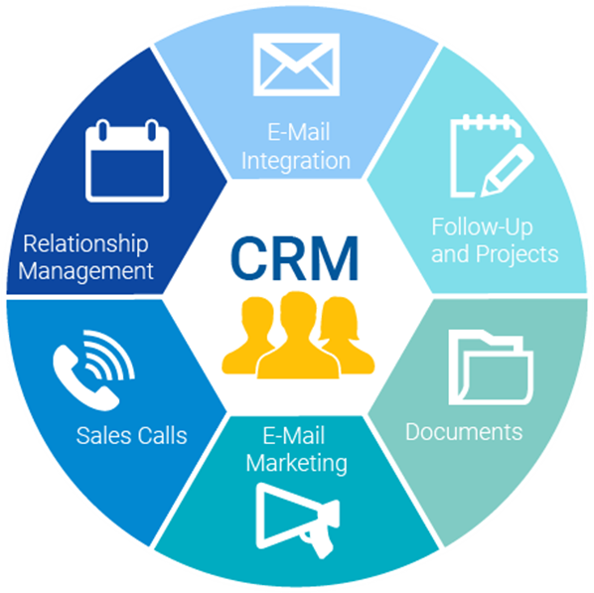
Customer Relationship Management

Slide 2
Defining Customer Relationship Management
Operational Customer Relationship Management Systems
Analytical Customer Relationship Management Systems

Slide 3
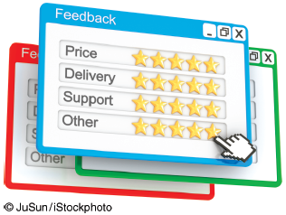
Rating Online Customer Service
Why is it so valuable for an online retailer to be able to post StellaService’s seal of approval on its Web site and advertising materials?
Why doesn’t StellaService provide the same service for bricks-and-mortar retailers?

Slide 4
Defining Customer Relationship Management
Customer Touch Points: the numerous and diverse interactions organizations have with their customers including traditional customer touch points such as telephone contact, direct mailings, and actual physical interactions with customers during their visits to a store and the additional touch points that occur through organizational CRM systems such as e-mail, Web sites, and communications via smartphones.
Data Consolidation: the organization’s CRM systems must manage customer data effectively with modern interconnected systems built around a data warehouse to make all customer-related data available to every unit of the business.
360° Data View Customer: complete data set on each customer that allows a company can enhance its relationship with its customers and ultimately make more productive and profitable decisions.
-----------------
Data consolidation and the 360° view of the customer enable the organization’s functional areas to readily share information about customers which leads to collaborative CRM.
Collaborative CRM Systems: provide effective and efficient interactive communication in all aspects of marketing, sales, and customer support with the customer throughout the entire organization.
Notes:
Customer Touch Points: the numerous and diverse interactions organizations have with their customers including traditional customer touch points such as telephone contact, direct mailings, and actual physical interactions with customers during their visits to a store and the additional touch points that occur through organizational CRM systems such as e-mail, Web sites, and communications via smartphones.
Data Consolidation: the organization’s CRM systems must manage customer data effectively with modern interconnected systems built around a data warehouse to make all customer-related data available to every unit of the business.
360° Data View Customer: complete data set on each customer that allows a company can enhance its relationship with its customers and ultimately make more productive and profitable decisions.
-----------------
Data consolidation and the 360° view of the customer enable the organization’s functional areas to readily share information about customers which leads to collaborative CRM.
Collaborative CRM Systems: provide effective and efficient interactive communication in all aspects of marketing, sales, and customer support with the customer throughout the entire organization.

Slide 5

’S ABOUT BUSINESS 12.1
Amazon: Truly Superb Customer Service
Describe the advantages that Amazon has over bricks-and-mortar retailers.
Describe the many facets of Amazon’s relentless focus on customer relationship management.

Slide 6
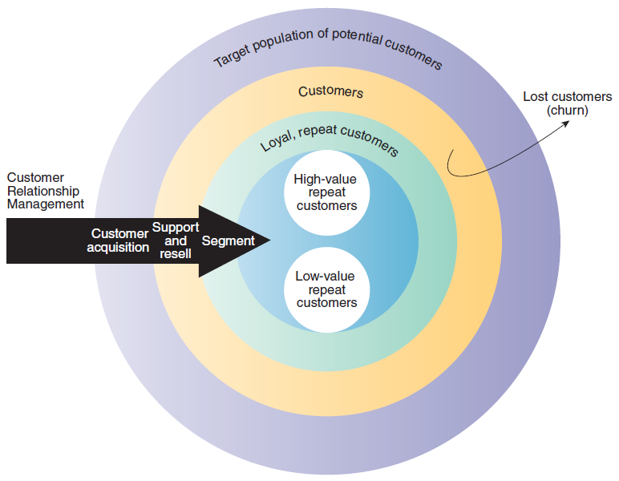
CRM Process

Slide 7
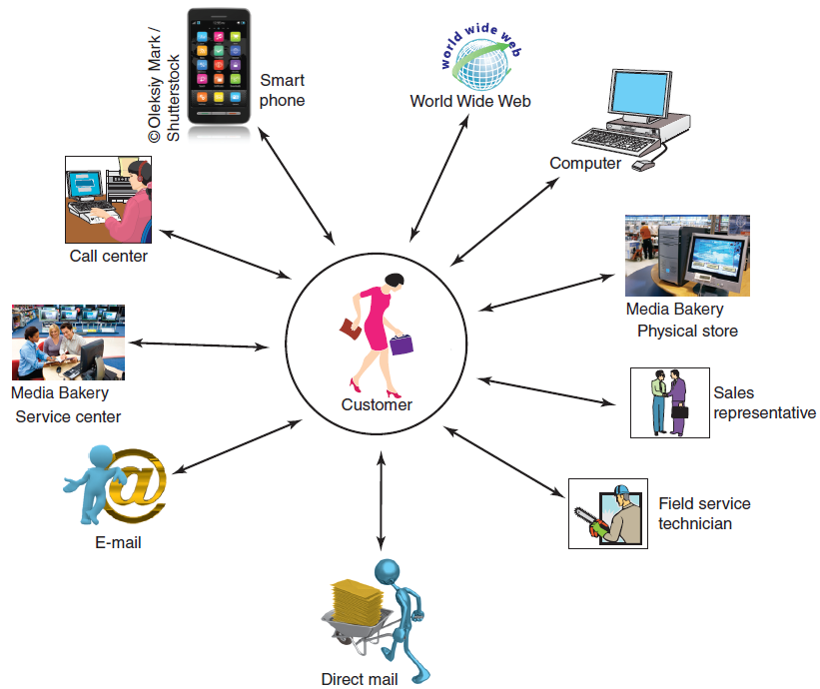
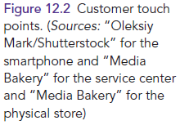
Figure 12.2: Customer Touchpoints

Slide 8
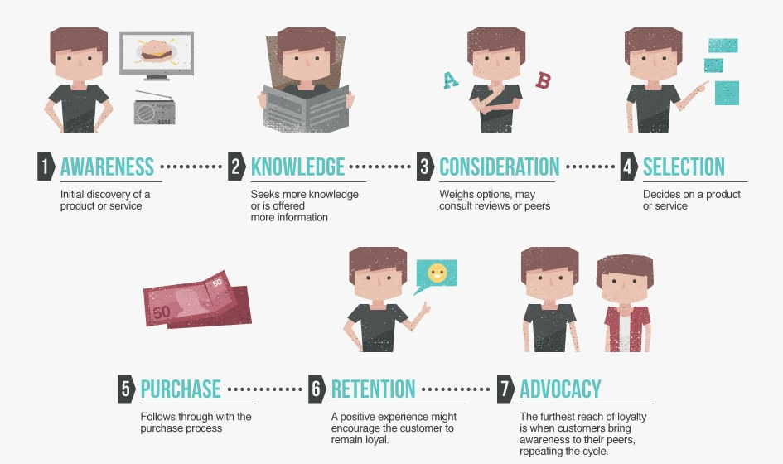
The Customer Lifecycle

Slide 9
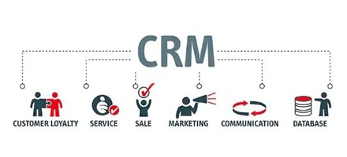

Slide 10
CRM
CRM stands for customer relationship management. It's a category of integrated, data-driven software solutions that improve how you interact and do business with your customers.
CRM systems help you manage and maintain customer relationships, interactions, track sales leads, marketing, and pipeline, and deliver actionable data.
CRM works throughout the customer lifecycle, with the goal of improving customer service relationships and assisting in customer retention and driving sales growth.

Slide 11
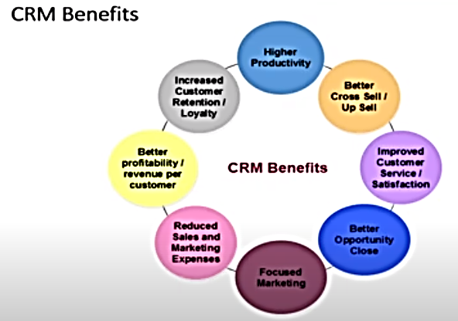

Slide 12
BUSINESS BENEFITS OF CRM
CRM enables an organization to:
Provide better customer service
Make call centers more efficient
Cross sell products more effectively
Help sales staff close deals faster
Simplify marketing and sales processes
Discover new Customers
Increase customer revenues
Notes:
As the business world increasingly shifts from product-focus to customer-focus, most organizations recognize that treating existing customers well is the best source of profitable and sustainable revenue growth
Ask your students why, in the age of e-business, an organization is challenged more than ever before to truly satisfy its customers
Business 2.0 ranked "You - the customer" as one of the 50 people who matter now for 2006. http://money.cnn.com/magazines/business2/peoplewhomatter/
These Web sites show the power people have in the consumer market today
http://www.ihatedell.net/
http://www.donotbuydodge.ca/

Slide 13
CRM BASICS
Organizations can find their most valuable customers through “RFM”:
How recently a customer purchased items (Recency)
How frequently a customer purchased items (Frequency)
How much a customer spends on each purchase (Monetary Value)
Notes:
Once a company knows this information, it can begin to strategize marketing campaigns, sales promotions, and other ways to increase business
For example: If Ms. Smith buys only at the height of the season, then the company should send her a special offer during the “off-season”
Ask your students if they have received any personalized promotions lately
How did the company gather information on the student to be able to offer the personalized promotion?

Slide 14
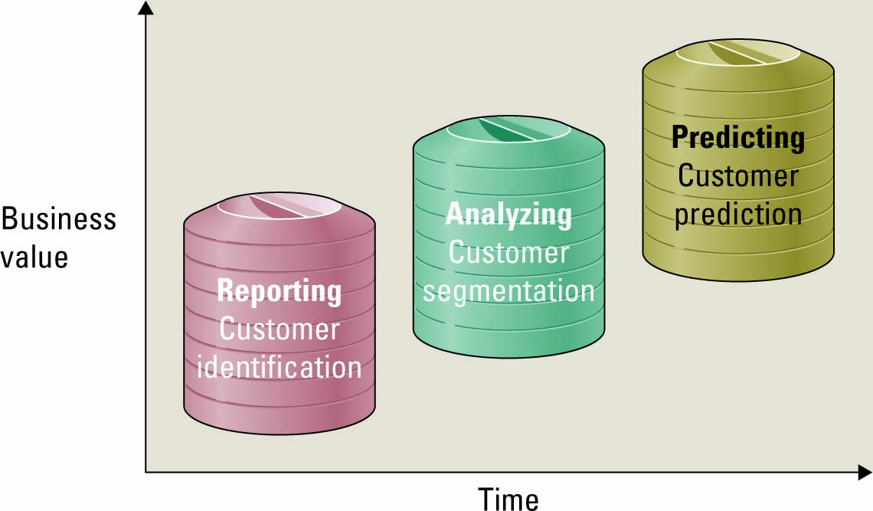
The Evolution of CRM
Three phases in the evolution of CRM include reporting, analyzing, and predicting
Notes:
Reporting
Help organizations identify their customers across applications
Analyzing
Help organizations segment their customers into categories such as best and worst customers
Predicting
Help organizations make predictions regarding customer behavior such as which customers are at risk of leaving

Slide 15
The Evolution of CRM
CRM reporting technology – help organizations identify their customers across other applications
CRM Analyzing technologies – help organization segment their customers into categories such as best and worst customers
CRM predicting technologies – help organizations make predictions regarding customer behavior such as which customers are at risk of leaving
Notes:
Reporting
Help organizations identify their customers across applications
Analyzing
Help organizations segment their customers into categories such as best and worst customers
Predicting
Help organizations make predictions regarding customer behavior such as which customers are at risk of leaving

Slide 16
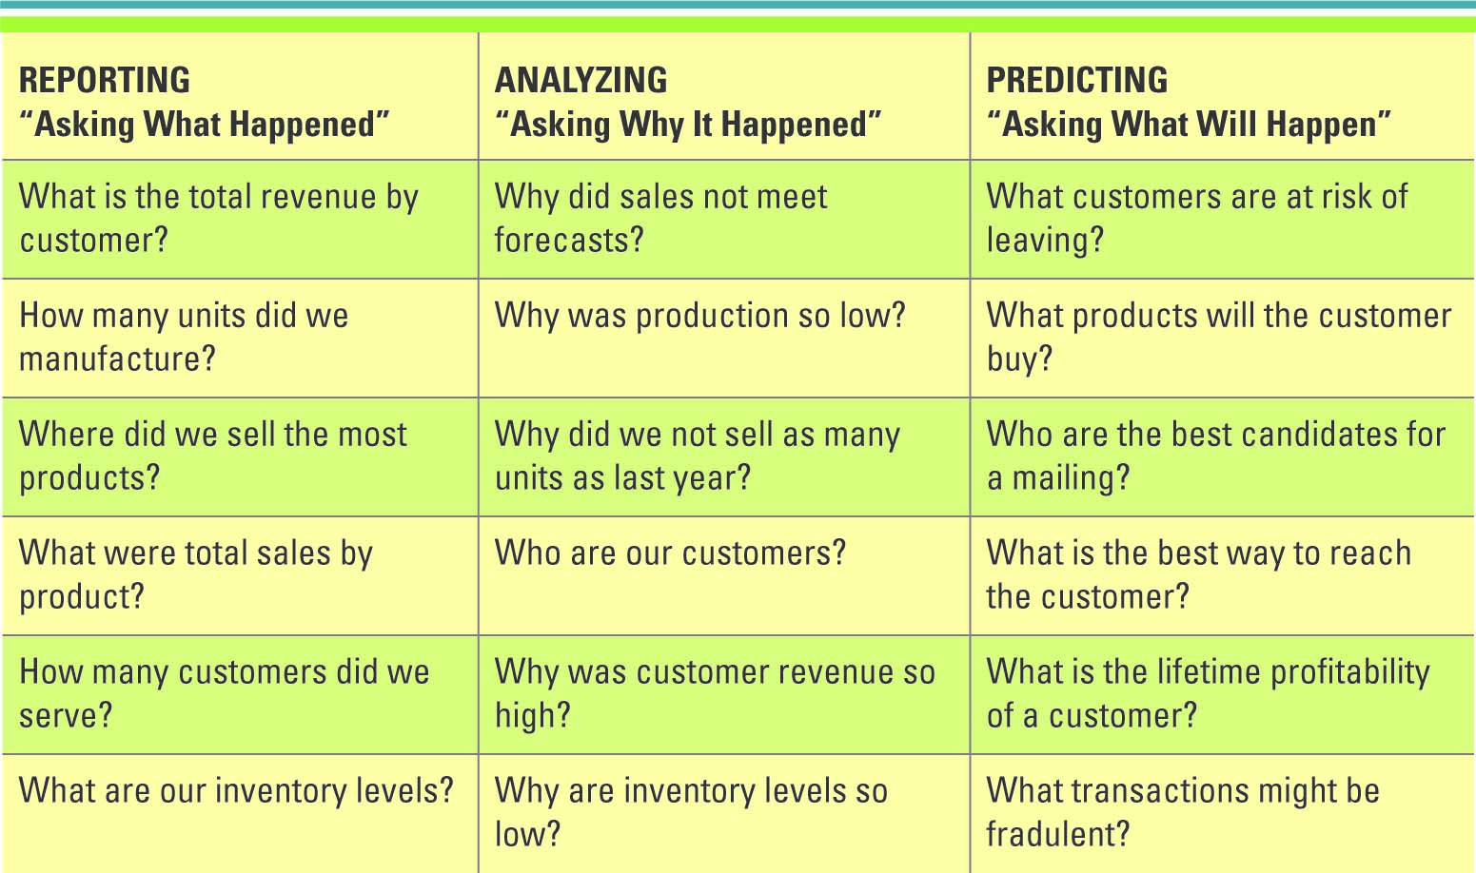
The Evolution of CRM
Notes:
Ask your students to define additional examples of reporting, analyzing, and predicting questions
CLASSROOM EXERCISE
Implementing a CRM Strategy
Organizations can find their most valuable customers through “RFM” - Recency, Frequency, and Monetary value
How recently a customer purchased items (Recency)
How frequently a customer purchased items (Frequency)
How much a customer spends on each purchase (Monetary Value)
Break your students into groups and ask them to form a CRM strategy for a new company that sells office supplies. Have your students present their strategy to the class. The strategy should address how to gain new customers and how to keep existing customers. For example,
The company should create personal promotions for its best customers
The company should target new customers in the surrounding area, especially business customers
The company should try to buy a list of business customers in the area from a valid source
The company should advertise in local trade papers, newspapers, radio stations, and restaurants
The company should track the responses it receives from the various advertising sources

Slide 17
Operational and Analytical CRM
Operational CRM – supports traditional transactional processing for day-to-day front-office operations or systems that deal directly with the customers
Analytical CRM – supports back-office operations and strategic analysis and includes all systems that do not deal directly with the customers
Notes:
Can you list a few examples of front-office systems?
Customer service, sales, billing
Can you list a few examples of back-office systems?
Accounting, finance, human resources, data warehouses
Ask your students which systems are more important to an organization – front-office or back-office
Ans: Both, one cannot function without the other
CLASSROOM EXERCISE
Designing a Digital Dashboard for a CRM System
Digital dashboards offer an effective and efficient way to view enterprisewide information at near real-time. According to Nucleus Research, there is a direct correlation between use of digital dashboards and a company’s return on investment (ROI), hence all executives should be using or pushing the development of digital dashboards to monitor and analyze organizational operations.
Break your students into groups and ask them to develop a digital dashboard for a CRM system. Be sure your students have addressed all of the following in their digital dashboard:
Customers
Sales
Marketing
Customer service
Order entry
Billing
Collections
Credit limits
Shipping
Transportation

Slide 18
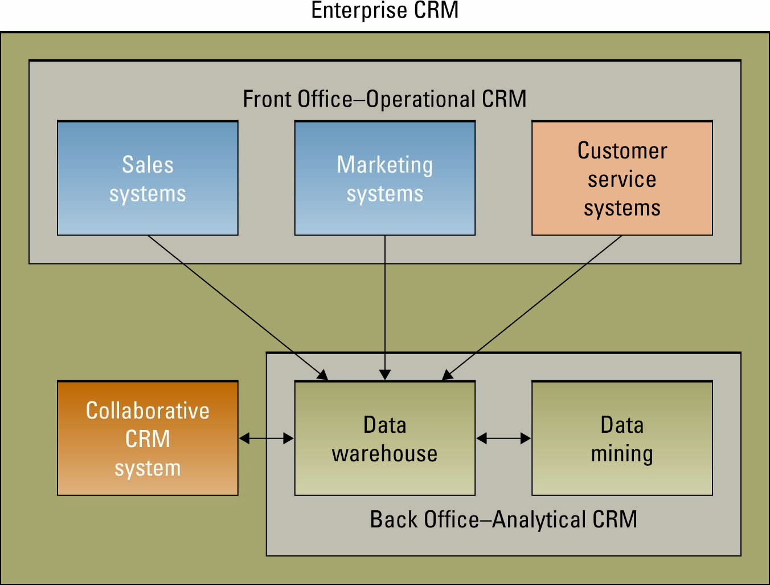
Operational and Analytical CRM
Notes:
Walk-through the Figure with your students
Why would an organization have a separate system for each front-office system and each back-office system?
Most organizations operate functional “silos”, and each department typically has its own systems
A company might purchase an ERP and then all of the functional silos would be on one system, however, this doesn’t happen very often in the real world. Most organizations require anywhere from 10 to 100 to 1,000 different systems to run their business
Finding one system that could meet all the needs of an entire organization from billing to sales is almost impossible
For this reason, the CRM system is the integrator, gathering all of the customer information from the many different system to obtain a single view of the customer
Personalization is one of the benefits of an analytical CRM system
Personalization occurs when a Web site can know enough about a person’s likes and dislikes that it can fashion offers that are more likely to appeal to that person

Slide 19
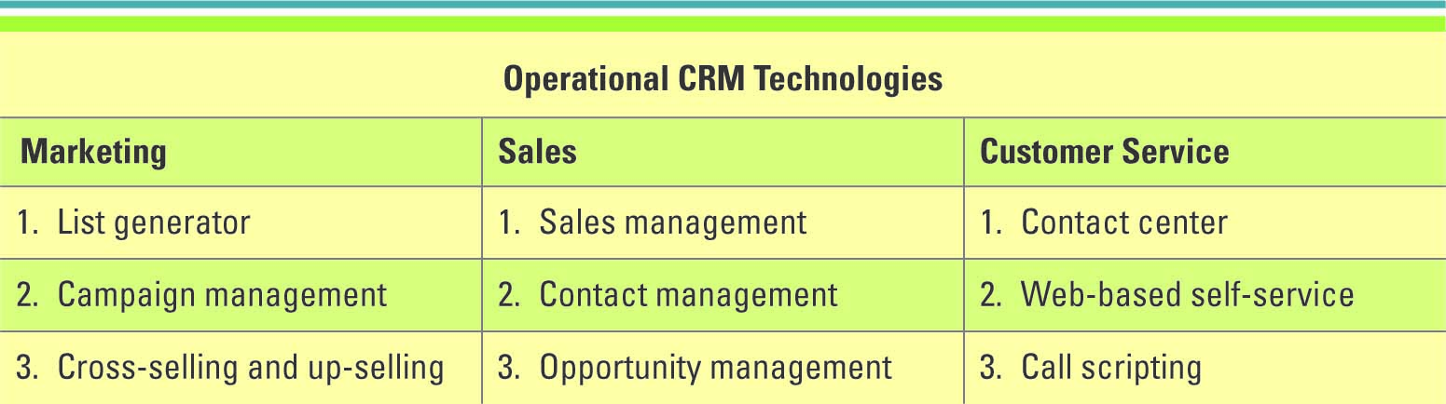
Using IT to Drive Operational CRM
Notes:
Operational CRM technologies for sales, marketing, and customer service departments

Slide 20
Marketing and Operational CRM
Three marketing operational CRM technologies:
List generator – compiles customer information from a variety of sources and segment the information for different marketing campaigns
Campaign management system – guides users through marketing campaigns
Cross-selling and up-selling
Cross-selling – selling additional products or services
Up-selling – increasing the value of the sale
Notes:
How many of you are marketing majors?
Do you anticipate using these types of technologies in the marketing department?

Slide 21
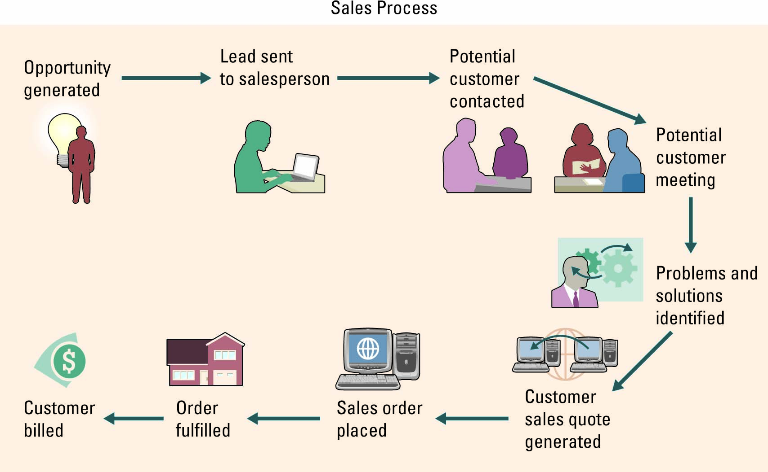
Sales and Operational CRM
The sales department was the first to begin developing CRM systems with sales force Management – a system that automatically tracks all of the steps in the sales process
Notes:
Walk your students through the sales process displayed in the above figure

Slide 22
Sales and Operational CRM
Sales and operational CRM technologies
Sales management CRM system – automates each phase of the sales process, helping individual sales representatives coordinate and organize all of their accounts
Contact management CRM system – maintains customer contact information and identifies potential customers for future sales
Opportunity management CRM system – targets sales opportunities by finding probable customers or companies for future sales

Slide 23
Customer Service and Operational CRM
Three customer service operational CRM technologies:
Contact center (call center)
Web-based self-service system
Click-to-talk
Call scripting system
Access DB to automatically generate details for the CSR
Notes:
Contact center (call center) – where CSRs answer customer inquiries and respond to problems through different touchpoints
Web-based self-service system – allow customers to use the Web to find answers to their questions or solutions to their problems
Click-to-talk –customers click on a button and talk with a CSR via the Internet
Call scripting system – access organizational databases that track similar issues or questions and automatically generate the details to the CSR who can then relay them to the customer
Documedics is a health care consulting company that provides reimbursement information about pharmaceutical products to patients and health care professionals. The company currently supports inquiries for 12 pharmaceutical companies and receives over 30,000 customer calls per month. Originally, the company had a data file for each patient and for each pharmaceutical company. This inefficient process resulted in the potential for a single patient to have up to 12 different information files if the patient was a client of all 12 pharmaceutical companies. To answer customer questions, a CSR had to download each customer file causing tremendous inefficiencies and confusion.

Slide 24
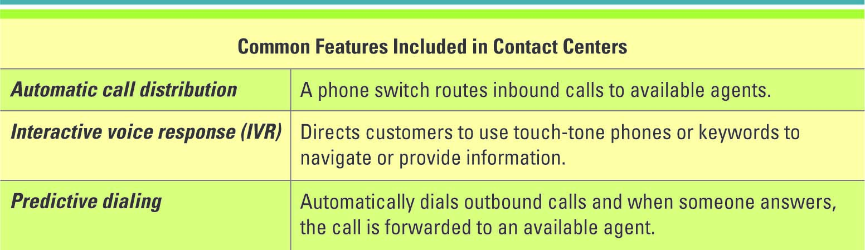
Customer Service and Operational CRM
Notes:
A contact center is part of the customer service department and falls into the category of operational CRM
A contact center (call center) is where CSRs answer customer inquiries and respond to problems through different touchpoints
A contact center is one of the best assets a customer-driven organization can have because maintaining a high level of customer support is critical to obtaining and retaining customers
Automatic call distribution, IVR, and predictive dialing are only three of many different systems available to help an organization automate its contact centers

Slide 25
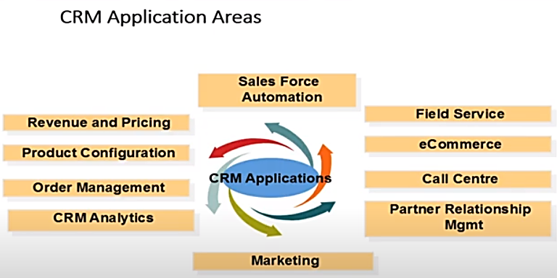

Slide 26
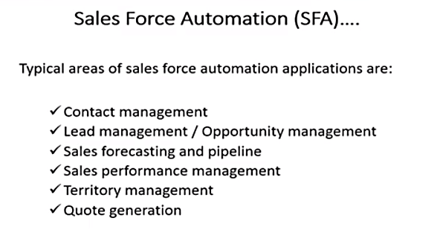

Slide 27
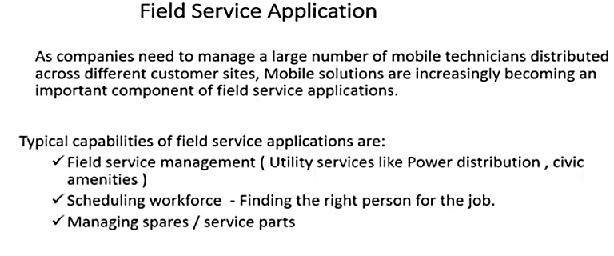

Slide 28


Slide 29
12.2
Operational Customer Relationship Management System
Customer-Facing Applications
Customer-Touching Applications
Notes:
Operational CRM: systems that support front-office business processes.
Front-Office Processes: those processes that directly interact with customers (i.e., sales, marketing, and service).
Customer-Facing Applications: allow an organization’s sales, field service, and customer interaction center representatives interact directly with customers through customer service and support, sales force automation, marketing, and campaign management.
Customer-Touching Applications: (or electronic CRM e-CRM) customer self-help applications/technologies.
-----------------
Two Major Components of Operational CRM:
Customer-Facing Applications
Customer-Touching Applications
-------------------

Slide 30
12.2
Operational Customer Relationship Management System
Operational CRM: systems that support front-office business processes.
Front-Office Processes: those processes that directly interact with customers (i.e., sales, marketing, and service).
Two Major Components of Operational CRM:
Customer-Facing Applications
Customer-Touching Applications
Customer-Facing Applications: allow an organization’s sales, field service, and customer interaction center representatives interact directly with customers through customer service and support, sales force automation, marketing, and campaign management.
Customer-Touching Applications: (or electronic CRM e-CRM) customer self-help applications/technologies.
Notes:
Operational CRM: systems that support front-office business processes.
Front-Office Processes: those processes that directly interact with customers (i.e., sales, marketing, and service).
Customer-Facing Applications: allow an organization’s sales, field service, and customer interaction center representatives interact directly with customers through customer service and support, sales force automation, marketing, and campaign management.
Customer-Touching Applications: (or electronic CRM e-CRM) customer self-help applications/technologies.
-----------------
Two Major Components of Operational CRM:
Customer-Facing Applications
Customer-Touching Applications
-------------------

Slide 31
Customer Facing Applications
Sales Force Automation (SFA): the component of an operational CRM system that automatically records all of the components in a sales transaction process.
Marketing: CRM Marketing applications use data mining to sift through volumes of customer data
Campaign Management: applications that help organizations plan campaigns that send the right messages to the right people through the right channels (e.g., avoid targeting people who have opted out of receiving marketing communications).
Notes:
Customer-Facing Applications: allow an organization’s sales, field service, and customer interaction center representatives interact directly with customers through customer service and support, sales force automation, marketing, and campaign management.
Sales Force Automation (SFA): the component of an operational CRM system that automatically records all of the components in a sales transaction process.
Marketing: CRM Marketing applications use data mining to sift through volumes of customer data
Campaign Management: applications that help organizations plan campaigns that send the right messages to the right people through the right channels (e.g., avoid targeting people who have opted out of receiving marketing communications).

Slide 32
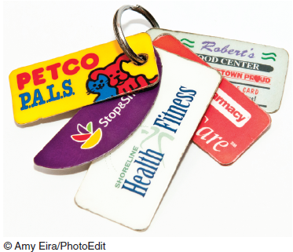
Customer Facing Applications: Customer Service & Support
Customer Interaction Centers (CIC)
Call Center
Outbound Telesales
Inbound Teleservice
Information Help Desk
Live Chat
Notes:
Customer-Facing Applications: allow an organization’s sales, field service, and customer interaction center representatives interact directly with customers through customer service and support, sales force automation, marketing, and campaign management.
--------------
Customer Service and Support: systems that automate service requests, complaints, product returns, and requests for information.
Customer Interaction Centers (CIC): where organizational representatives use multiple channels such as the Web, telephone, fax, and face-to-face interactions to communicate with customers.
Call Center: a centralized office set up to receive and transmit a large volume of requests by telephone.
Oubound Telesales: the CIC generates a call list for the sales team, whose members contact sales prospects.
Inbound Teleservice: customers communicate directly with the CIC to initiate a sales order, inquire about products and services before placing an order, and obtain information about a transaction they have already made.
Information Help Desk: assists customers with their questions concerning products or services, and it also processes customer complaints.
Live Chat: allows customers to connect to a company representative and conduct an instant messaging session enabling the participants to share documents and photos.

Slide 33
Customer Facing Applications: Customer Service & Support
Customer Service and Support: systems that automate service requests, complaints, product returns, and requests for information.
Customer Interaction Centers (CIC): where organizational representatives use multiple channels such as the Web, telephone, fax, and face-to-face interactions to communicate with customers.
Call Center: a centralized office set up to receive and transmit a large volume of requests by telephone.
Oubound Telesales: the CIC generates a call list for the sales team, whose members contact sales prospects.
Inbound Teleservice: customers communicate directly with the CIC to initiate a sales order, inquire about products and services before placing an order, and obtain information about a transaction they have already made.
Information Help Desk: assists customers with their questions concerning products or services, and it also processes customer complaints.
Live Chat: allows customers to connect to a company representative and conduct an instant messaging session enabling the participants to share documents and photos.
Notes:
Customer-Facing Applications: allow an organization’s sales, field service, and customer interaction center representatives interact directly with customers through customer service and support, sales force automation, marketing, and campaign management.
--------------
Customer Service and Support: systems that automate service requests, complaints, product returns, and requests for information.
Customer Interaction Centers (CIC): where organizational representatives use multiple channels such as the Web, telephone, fax, and face-to-face interactions to communicate with customers.
Call Center: a centralized office set up to receive and transmit a large volume of requests by telephone.
Oubound Telesales: the CIC generates a call list for the sales team, whose members contact sales prospects.
Inbound Teleservice: customers communicate directly with the CIC to initiate a sales order, inquire about products and services before placing an order, and obtain information about a transaction they have already made.
Information Help Desk: assists customers with their questions concerning products or services, and it also processes customer complaints.
Live Chat: allows customers to connect to a company representative and conduct an instant messaging session enabling the participants to share documents and photos.

Slide 34
Customer Facing Applications: Sales Force Automation
Contact Management System
Sales Lead Tracking System
Sales Forecasting System
Product Knowledge System
Configurator
Notes:
Customer-Facing Applications: allow an organization’s sales, field service, and customer interaction center representatives interact directly with customers through customer service and support, sales force automation, marketing, and campaign management.
--------------
Sales Force Automation (SFA): the component of an operational CRM system that automatically records all of the components in a sales transaction process.
Contact Management System: tracks all communications between the company and the customer, the purpose of each communication, and any necessary follow-up which eliminates duplicated contacts and redundancy, which in turn reduces the risk of irritating customers.
Sales Lead Tracking System: lists potential customers or customers who have purchased related products; that is, products similar to those that the salesperson is trying to sell to the customer.
Sales Forecasting System: a mathematical technique for estimating future sales.
Product Knowledge System: a comprehensive source of information regarding products and services.
Configurator: an online product-building feature that enables customers to model the product to meet their specific needs.

Slide 35
Customer Facing Applications: Sales Force Automation
Sales Force Automation (SFA): the component of an operational CRM system that automatically records all of the components in a sales transaction process.
Contact Management System: tracks all communications between the company and the customer, the purpose of each communication, and any necessary follow-up which eliminates duplicated contacts and redundancy, which in turn reduces the risk of irritating customers.
Sales Lead Tracking System: lists potential customers or customers who have purchased related products; that is, products similar to those that the salesperson is trying to sell to the customer.
Sales Forecasting System: a mathematical technique for estimating future sales.
Product Knowledge System: a comprehensive source of information regarding products and services.
Configurator: an online product-building feature that enables customers to model the product to meet their specific needs.
Notes:
Customer-Facing Applications: allow an organization’s sales, field service, and customer interaction center representatives interact directly with customers through customer service and support, sales force automation, marketing, and campaign management.
--------------
Sales Force Automation (SFA): the component of an operational CRM system that automatically records all of the components in a sales transaction process.
Contact Management System: tracks all communications between the company and the customer, the purpose of each communication, and any necessary follow-up which eliminates duplicated contacts and redundancy, which in turn reduces the risk of irritating customers.
Sales Lead Tracking System: lists potential customers or customers who have purchased related products; that is, products similar to those that the salesperson is trying to sell to the customer.
Sales Forecasting System: a mathematical technique for estimating future sales.
Product Knowledge System: a comprehensive source of information regarding products and services.
Configurator: an online product-building feature that enables customers to model the product to meet their specific needs.

Slide 36
Customer Facing Applications: Marketing
Marketing: CRM Marketing applications use data mining to sift through volumes of customer data
Data Mining: develops a purchasing profile or snapshot of a consumer’s buying habits that may lead to additional sales through cross-selling, upselling, and bundling.
Cross-Selling: the marketing of additional related products to customers based on a previous purchase.
Upselling: a strategy in which the salesperson provides customers with the opportunity to purchase related products or services of greater value in place of, or along with, the consumer’s initial product or service selection.
Bundling: is a form of cross-selling in which a business sells a group of products or services together at a lower price than their combined individual prices.
Notes:
Customer-Facing Applications: allow an organization’s sales, field service, and customer interaction center representatives interact directly with customers through customer service and support, sales force automation, marketing, and campaign management.
--------------
Marketing: CRM Marketing applications use data mining to sift through volumes of customer data
Data Mining: develops a purchasing profile or snapshot of a consumer’s buying habits that may lead to additional sales through cross-selling, upselling, and bundling.
Cross-Selling: the marketing of additional related products to customers based on a previous purchase.
Upselling: a strategy in which the salesperson provides customers with the opportunity to purchase related products or services of greater value in place of, or along with, the consumer’s initial product or service selection.
Bundling: is a form of cross-selling in which a business sells a group of products or services together at a lower price than their combined individual prices.

Slide 37
Customer Facing Applications: Campaign Management
Campaign Management: applications that help organizations plan campaigns that send
Right messages
Right people
Right channels
Notes:
Customer-Facing Applications: allow an organization’s sales, field service, and customer interaction center representatives interact directly with customers through customer service and support, sales force automation, marketing, and campaign management.
--------------
Campaign Management: applications that help organizations plan campaigns that send the right messages to the right people through the right channels (e.g., avoid targeting people who have opted out of receiving marketing communications).

Slide 38
Customer Facing Applications: Campaign Management
Campaign Management: applications that help organizations plan campaigns that send the right messages to the right people through the right channels (e.g., avoid targeting people who have opted out of receiving marketing communications).
Notes:
Customer-Facing Applications: allow an organization’s sales, field service, and customer interaction center representatives interact directly with customers through customer service and support, sales force automation, marketing, and campaign management.
--------------
Campaign Management: applications that help organizations plan campaigns that send the right messages to the right people through the right channels (e.g., avoid targeting people who have opted out of receiving marketing communications).

Slide 39
Customer Touching Applications
Search & Comparison Capabilities
Technical and Other Information and Services
Customized Products and Services
Mass Customization
Personalized Web Pages
Frequently Asked Questions (FAQs)
E-mail and Automated Response
Loyalty Programs
Notes:
Customer-Touching Applications: (or electronic CRM e-CRM) customer self-help applications/technologies.
-----------------
Search and Comparison Capabilities: search and comparison capabilities offered to customers by online stores, online malls, and independent comparison Web sites.
Technical and Other Information and Services: personalized experiences offered by organizations to induce customers to make purchases or to remain loyal (e.g., allowing customers to download product manuals; providing detailed technical information, maintenance information, and replacement parts to customers).
Customized Products and Services: offering customers the ability to custimize products, view account balances, check shipping status of an order, etc.
Mass Customization: a process in which customers can configure their own products (e.g., customized computer systems from Dell).
Personalized Web Pages: organizations permit their customers to create personalized Web pages used to record purchases and preferences, as well as problems and requests.
Frequently Asked Questions (FAQs): a simple tool for answering repetitive customer queries and when customers find the information they need by using FAQs the need to communicate with an actual person is eliminated.
E-mail and Automated Response: the most popular tool for customer service, inexpensive, fast, and companies use e-mail not only to answer customer inquiries but also to disseminate information, send alerts and product information, and conduct correspondence on any topic.
Loyalty Programs: programs that recognize customers who repeatedly use a vendor’s
products or services.

Slide 40
Customer Touching Applications
Customer-Touching Applications: (or electronic CRM e-CRM) customer self-help applications/technologies.
-----------------
Search and Comparison Capabilities: search and comparison capabilities offered to customers by online stores, online malls, and independent comparison Web sites.
Technical and Other Information and Services: personalized experiences offered by organizations to induce customers to make purchases or to remain loyal (e.g., allowing customers to download product manuals; providing detailed technical information, maintenance information, and replacement parts to customers).
Customized Products and Services: offering customers the ability to custimize products, view account balances, check shipping status of an order, etc.
Mass Customization: a process in which customers can configure their own products (e.g., customized computer systems from Dell).
Notes:
Customer-Touching Applications: (or electronic CRM e-CRM) customer self-help applications/technologies.
-----------------
Search and Comparison Capabilities: search and comparison capabilities offered to customers by online stores, online malls, and independent comparison Web sites.
Technical and Other Information and Services: personalized experiences offered by organizations to induce customers to make purchases or to remain loyal (e.g., allowing customers to download product manuals; providing detailed technical information, maintenance information, and replacement parts to customers).
Customized Products and Services: offering customers the ability to custimize products, view account balances, check shipping status of an order, etc.
Mass Customization: a process in which customers can configure their own products (e.g., customized computer systems from Dell).
Personalized Web Pages: organizations permit their customers to create personalized Web pages used to record purchases and preferences, as well as problems and requests.
Frequently Asked Questions (FAQs): a simple tool for answering repetitive customer queries and when customers find the information they need by using FAQs the need to communicate with an actual person is eliminated.
E-mail and Automated Response: the most popular tool for customer service, inexpensive, fast, and companies use e-mail not only to answer customer inquiries but also to disseminate information, send alerts and product information, and conduct correspondence on any topic.
Loyalty Programs: programs that recognize customers who repeatedly use a vendor’s
products or services.

Slide 41
Customer Touching Applications
Personalized Web Pages: organizations permit their customers to create personalized Web pages used to record purchases and preferences, as well as problems and requests.
Frequently Asked Questions (FAQs): a simple tool for answering repetitive customer queries and when customers find the information they need by using FAQs the need to communicate with an actual person is eliminated.
E-mail and Automated Response: the most popular tool for customer service, inexpensive, fast, and companies use e-mail not only to answer customer inquiries but also to disseminate information, send alerts and product information, and conduct correspondence on any topic.
Loyalty Programs: programs that recognize customers who repeatedly use a vendor’s products or services.
Notes:
Customer-Touching Applications: (or electronic CRM e-CRM) customer self-help applications/technologies.
-----------------
Search and Comparison Capabilities: search and comparison capabilities offered to customers by online stores, online malls, and independent comparison Web sites.
Technical and Other Information and Services: personalized experiences offered by organizations to induce customers to make purchases or to remain loyal (e.g., allowing customers to download product manuals; providing detailed technical information, maintenance information, and replacement parts to customers).
Customized Products and Services: offering customers the ability to custimize products, view account balances, check shipping status of an order, etc.
Mass Customization: a process in which customers can configure their own products (e.g., customized computer systems from Dell).
Personalized Web Pages: organizations permit their customers to create personalized Web pages used to record purchases and preferences, as well as problems and requests.
Frequently Asked Questions (FAQs): a simple tool for answering repetitive customer queries and when customers find the information they need by using FAQs the need to communicate with an actual person is eliminated.
E-mail and Automated Response: the most popular tool for customer service, inexpensive, fast, and companies use e-mail not only to answer customer inquiries but also to disseminate information, send alerts and product information, and conduct correspondence on any topic.
Loyalty Programs: programs that recognize customers who repeatedly use a vendor’s
products or services.

Slide 42
Analytical Customer Relationship Management (CRM) Systems
Analytical CRM Systems Analyze Customer Data for:
Targeted marketing campaigns
Increasing customer acquisition, cross-selling, and upselling
Products and services decision support
Financial forecasting
Customer profitability analysis
Notes:
Analytical CRM: provide business intelligence by analyzing customer behavior and perceptions providing information concerning customer requests and transactions, as well as customer responses to the organization’s marketing, sales, and service initiatives. These systems also create statistical models of customer behavior and the value of customer relationships over time, as well as forecasts about acquiring, retaining, and losing customers.
Analytical CRM Systems Analyze Customer Data for:
Designing and executing targeted marketing campaigns
Increasing customer acquisition, cross-selling, and upselling
Providing input into decisions relating to products and services (e.g., pricing and product development)
Providing financial forecasting and customer profitability analysis

Slide 43
Analytical Customer Relationship Management (CRM) Systems
Analytical CRM: provide business intelligence by analyzing customer behavior and perceptions providing information concerning customer requests and transactions, as well as customer responses to the organization’s marketing, sales, and service initiatives. These systems also create statistical models of customer behavior and the value of customer relationships over time, as well as forecasts about acquiring, retaining, and losing customers.
Notes:
Analytical CRM: provide business intelligence by analyzing customer behavior and perceptions providing information concerning customer requests and transactions, as well as customer responses to the organization’s marketing, sales, and service initiatives. These systems also create statistical models of customer behavior and the value of customer relationships over time, as well as forecasts about acquiring, retaining, and losing customers.
Analytical CRM Systems Analyze Customer Data for:
Designing and executing targeted marketing campaigns
Increasing customer acquisition, cross-selling, and upselling
Providing input into decisions relating to products and services (e.g., pricing and product development)
Providing financial forecasting and customer profitability analysis

Slide 44
Analytical Customer Relationship Management (CRM) Systems
Analytical CRM Systems Analyze Customer Data for:
Designing and executing targeted marketing campaigns
Increasing customer acquisition, cross-selling, and upselling
Providing input into decisions relating to products and services (e.g., pricing and product development)
Providing financial forecasting and customer profitability analysis
Notes:
Analytical CRM: provide business intelligence by analyzing customer behavior and perceptions providing information concerning customer requests and transactions, as well as customer responses to the organization’s marketing, sales, and service initiatives. These systems also create statistical models of customer behavior and the value of customer relationships over time, as well as forecasts about acquiring, retaining, and losing customers.
Analytical CRM Systems Analyze Customer Data for:
Designing and executing targeted marketing campaigns
Increasing customer acquisition, cross-selling, and upselling
Providing input into decisions relating to products and services (e.g., pricing and product development)
Providing financial forecasting and customer profitability analysis

Slide 45
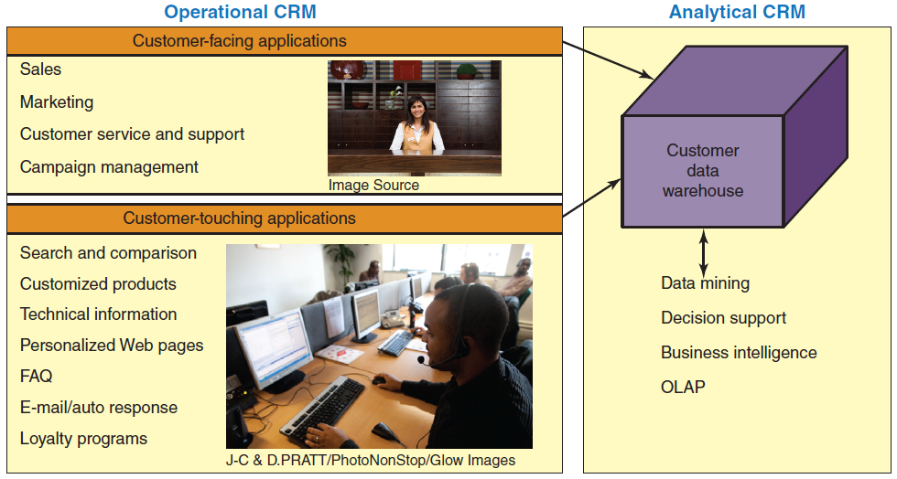
Figure 12.3: Relationship Between Operational CRM & Analytical CRM

